Slide 1
Owl M A Material Design Study App
K.Ibrahim sha - BB088DC68B542B396944B41F2F6C8DAE
R.Karthikeyan - 7144F059A9F8EC5BACE4944D988D8499
G.Vijayanandh - 7C389C8657531278A40451B7B461B6A0
K.Yogeshwaran - 26EF749E8677936A48640ACFC2326D6F

Slide 2
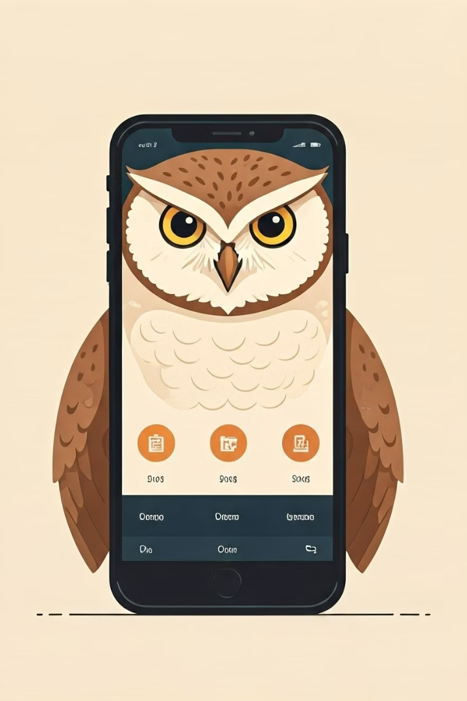
Owl Material Design Study App
Owl is a Material Design study app designed to help users learn effectively and efficiently. The app boasts a user-friendly interface, features that promote focused learning, and a visually appealing design.

Slide 3
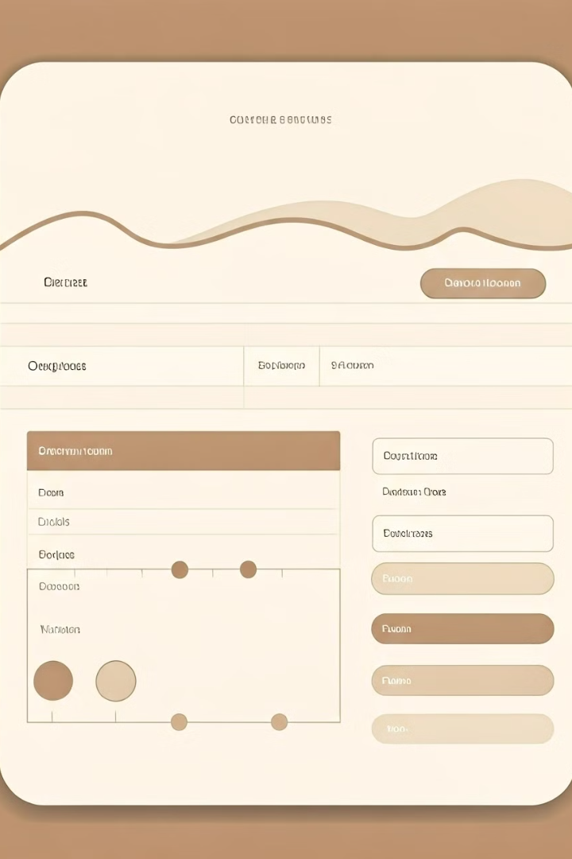
Introduction to Material Design
1
Google's Design Language
2
Emphasis on User Experience
Material Design is a comprehensive design system developed by Google, encompassing visual, interaction, and motion design.
Material Design prioritizes user-friendliness, intuitive navigation, and a visually appealing aesthetic.
3
Consistency and Flexibility
Material Design provides a set of guidelines and principles that ensure consistency across different platforms and devices.

Slide 4
Design Principles and Guidelines
Hierarchy
Color Palette
Typography
Establish visual hierarchy using typography, color, and spacing to guide the user's attention.
Adhere to the Material Design color system, selecting colors that communicate meaning and create a consistent visual style.
Use the Material Design typography system for clear readability and a consistent look and feel.

Slide 5
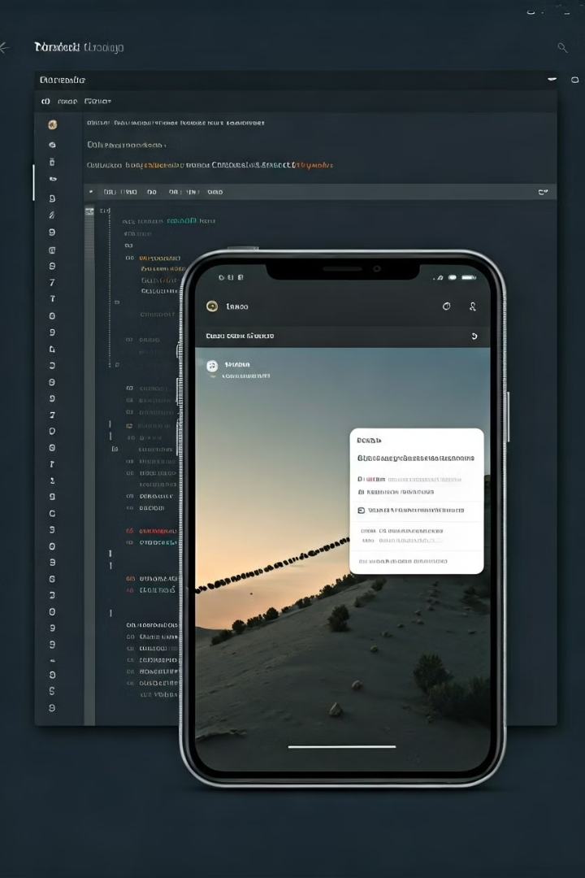
Implementing Material Design in Android
1
Android Jetpack
Utilize Jetpack components, such as Compose and Material, to implement Material Design features in your app.
2
Design Resources
Access Material Design libraries, documentation, and resources to assist with implementation.
3
Testing and Iteration
Continuously test and iterate on your design to ensure a seamless and engaging user experience.

Slide 6
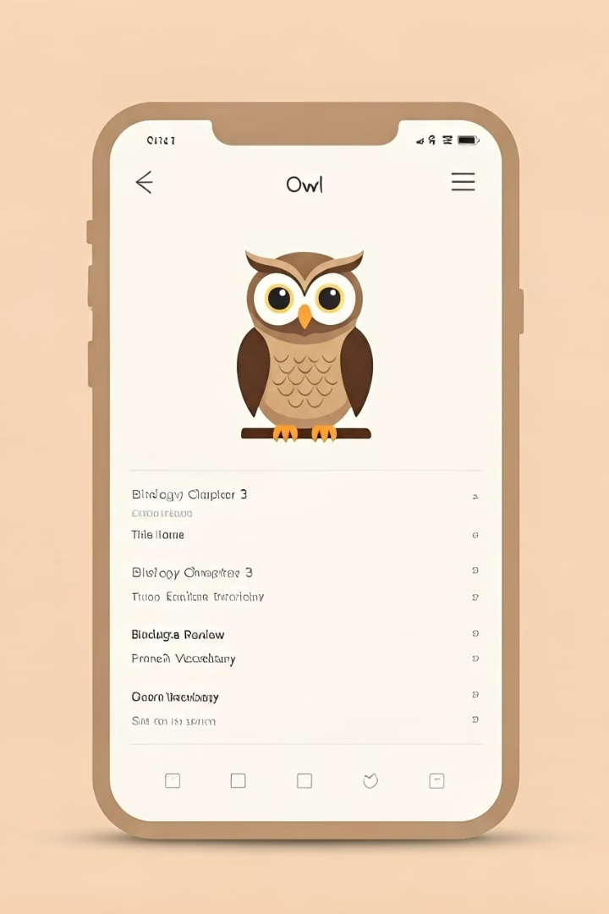
Owl App: Features and Functionality
Study Materials
Study Scheduler
Organize and access learning materials such as notes, flashcards, and quizzes.
Create a personalized study schedule to maintain consistency and track progress.
Progress Tracking
Monitor learning progress and identify areas that require additional focus.

Slide 7
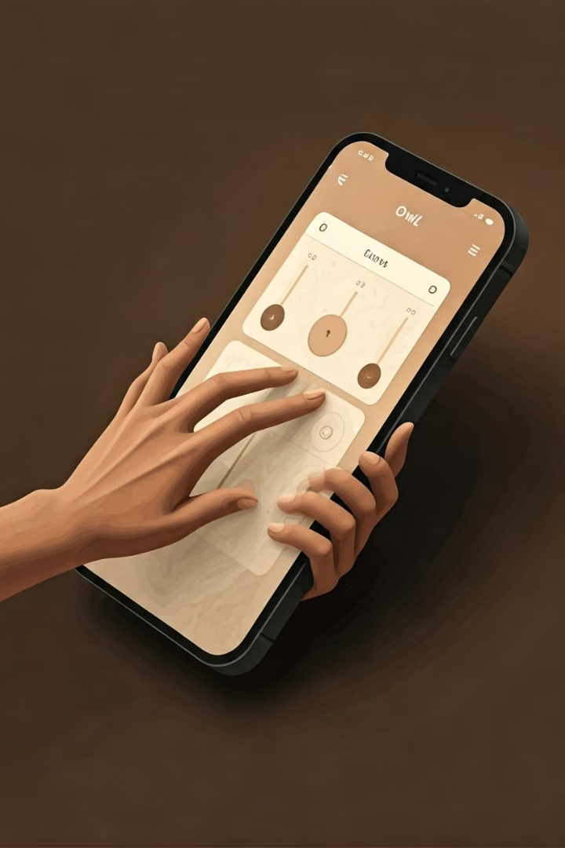
UI Components and Interactions
Component
Description
Cards
Display study materials in a visually appealing and organized manner.
Buttons
Provide clear and concise actions for users to interact with the app.
Sliders
Adjust study settings, such as timer duration or difficulty level.

Slide 8
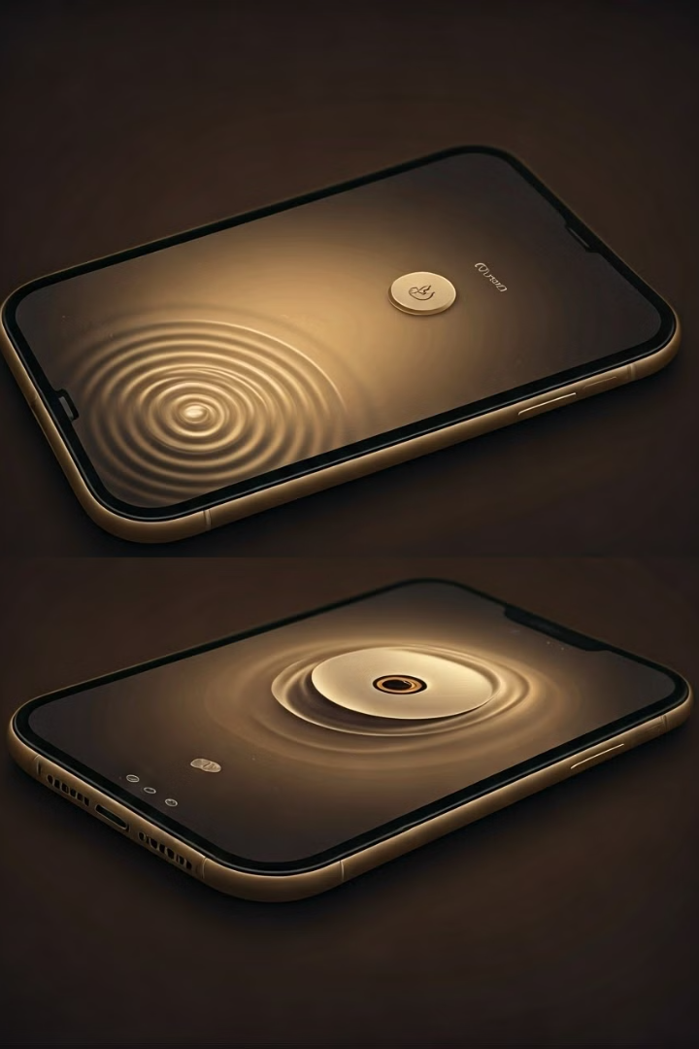
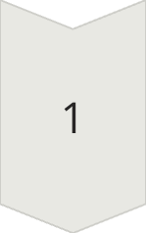
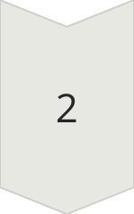
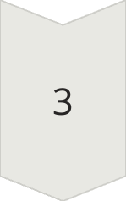
Animations and Transitions
Visual Feedback
Provide visual feedback to users, enhancing engagement and understanding.
User Guidance
Guide users through the app with smooth and intuitive transitions.
Aesthetic Enhancement
Enhance the overall visual appeal and user experience through animations.

Slide 9
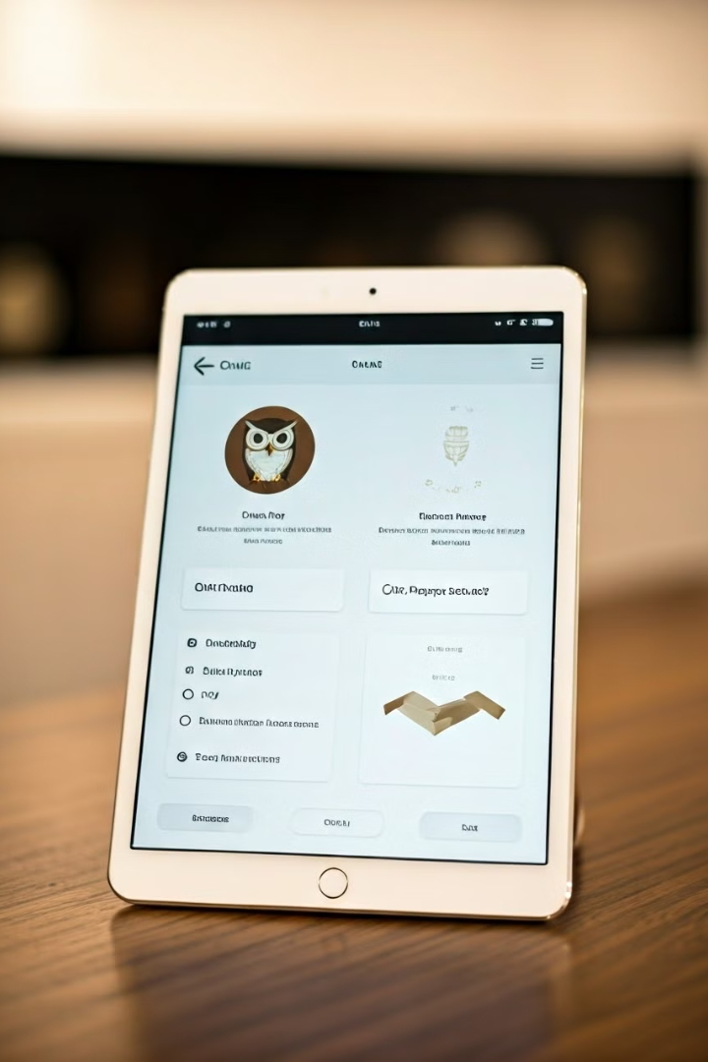



Conclusion and Next Steps
Future Development
Continue to enhance the Owl app with new features and improvements.
User Feedback
Gather feedback from users to identify areas for improvement.
Community Engagement
Foster a community of learners who can share resources and support each other.

Slide 10
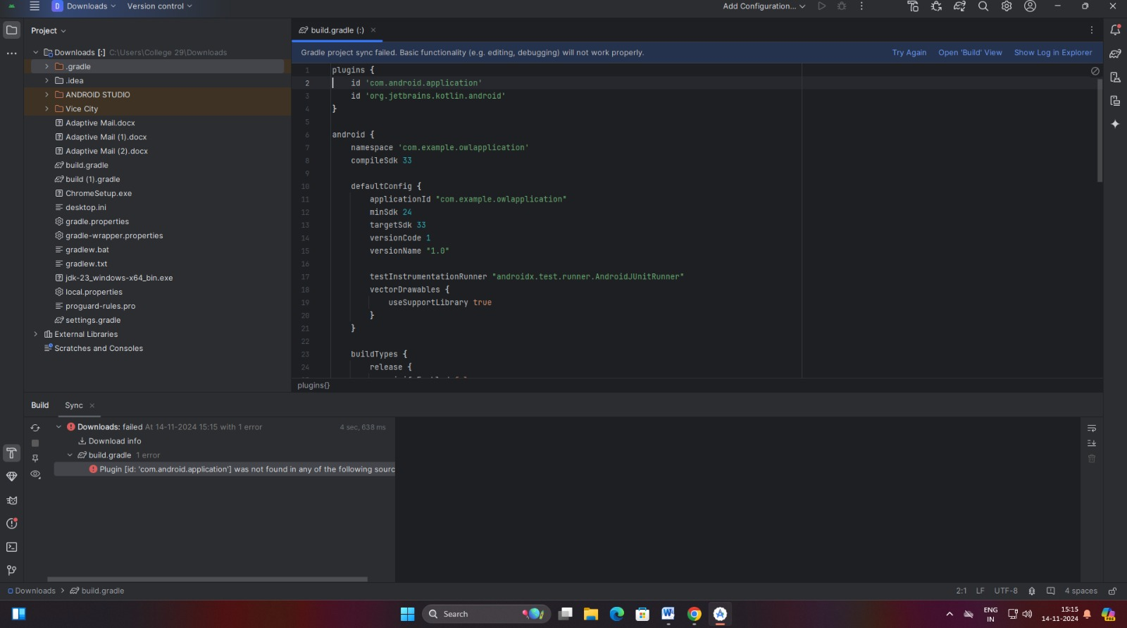

Slide 11
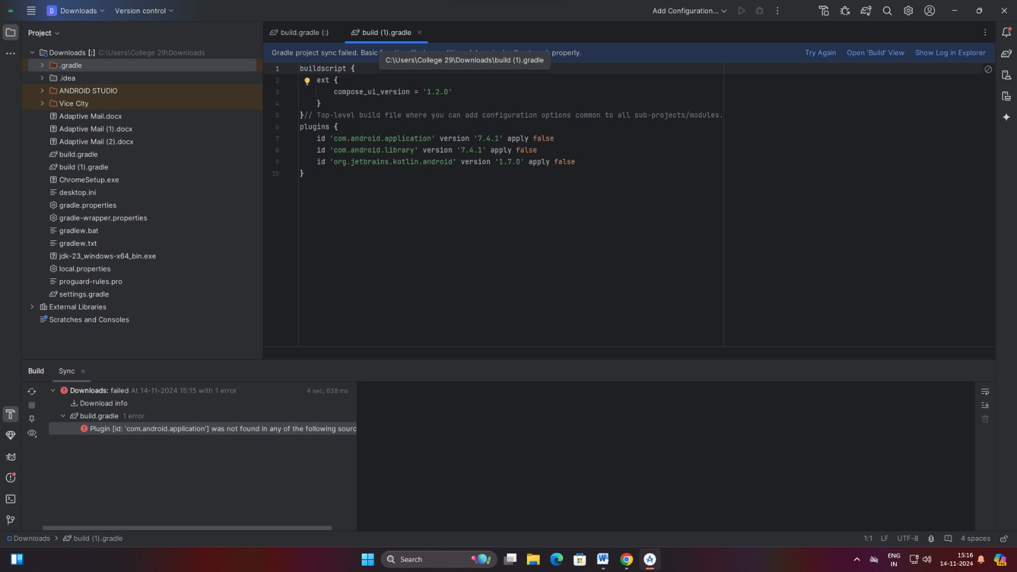

Slide 12
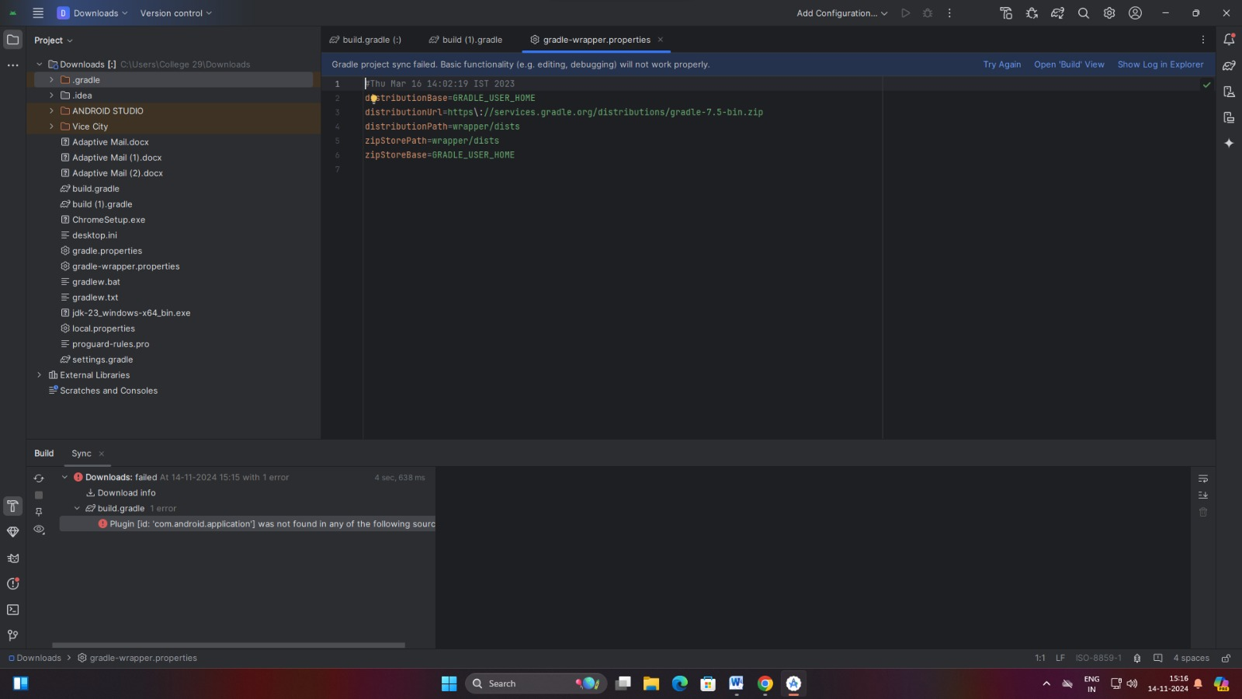

Slide 13
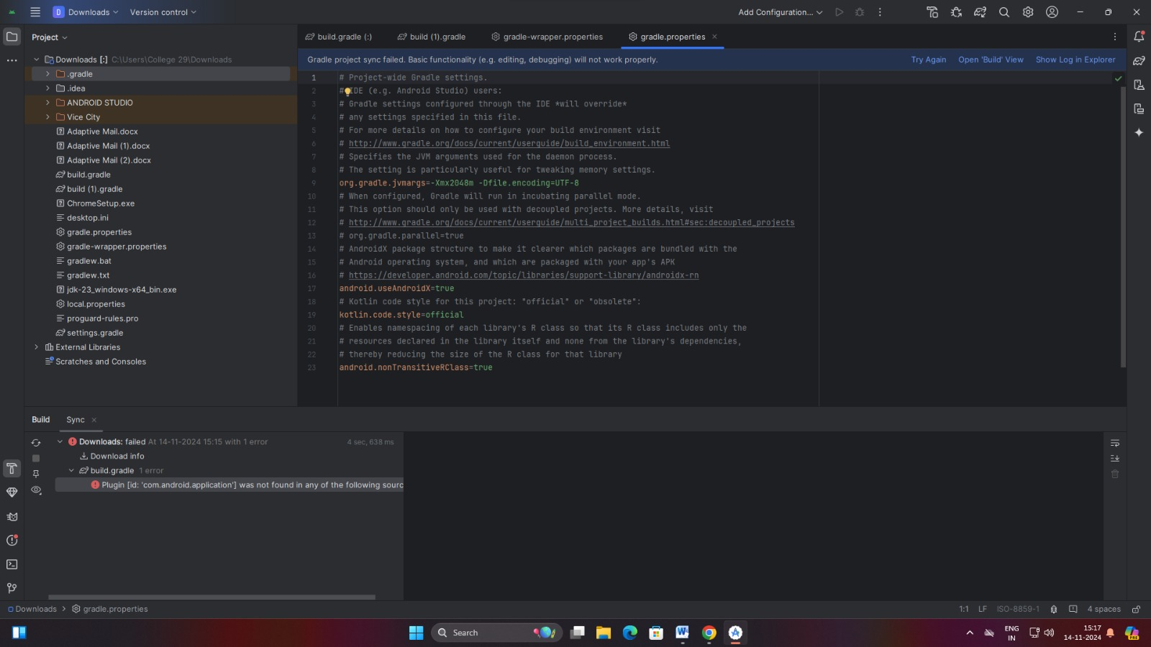

Slide 14
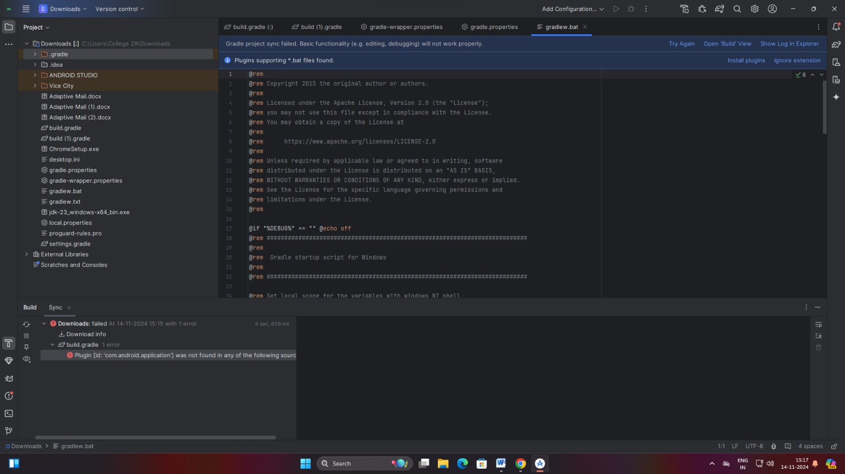

Slide 15
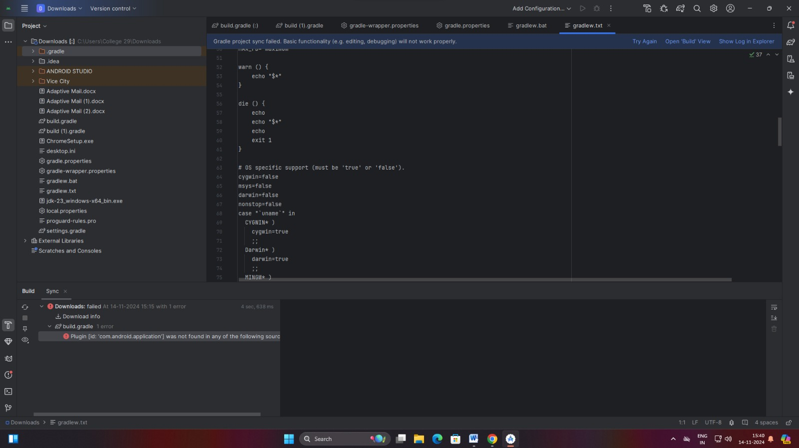

Slide 16
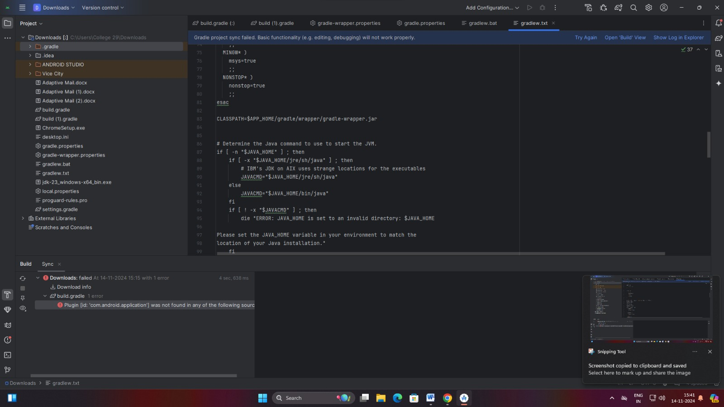

Slide 17
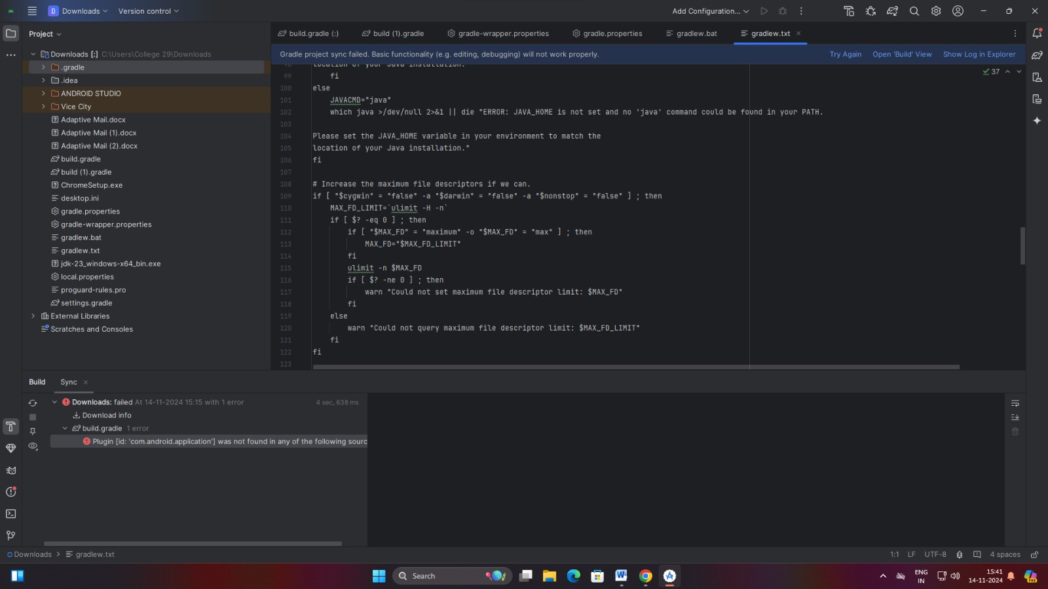

Slide 18
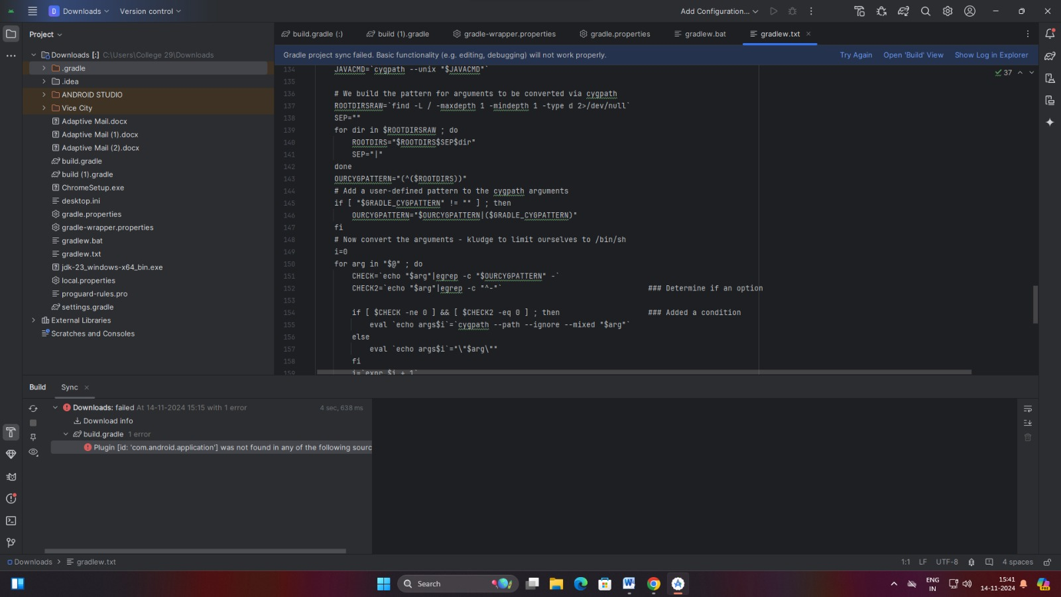

Slide 19
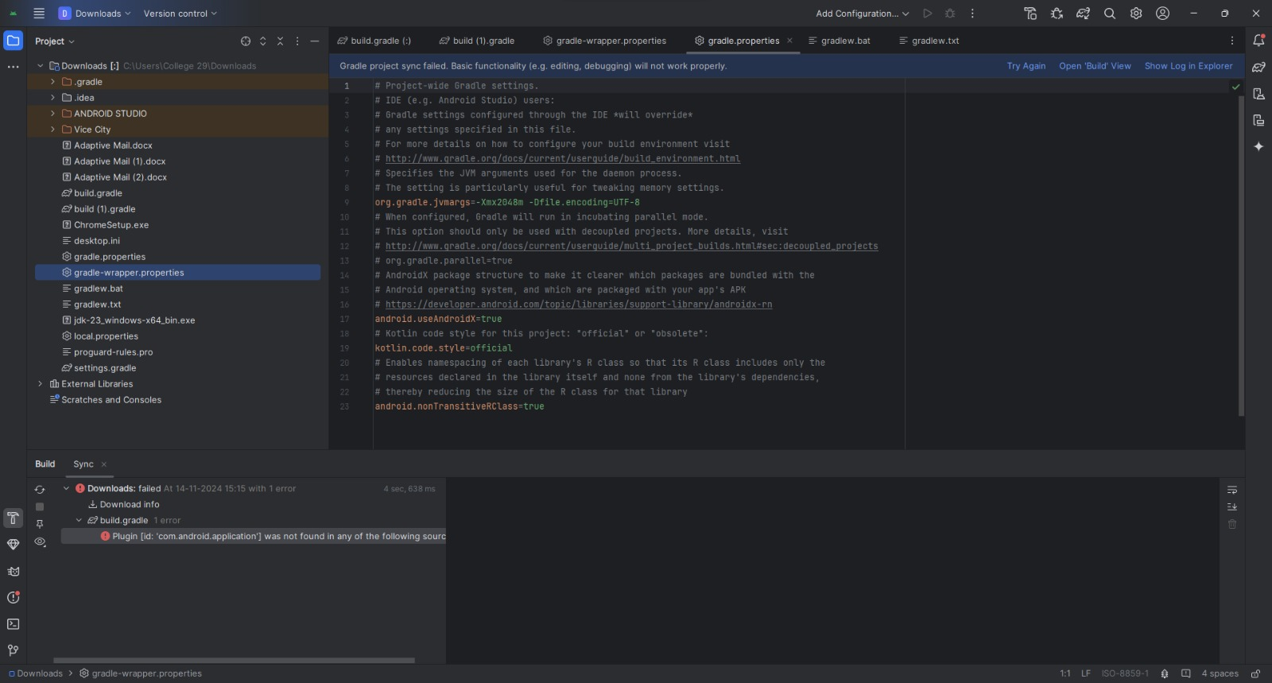

Slide 20
**Thank You**

